Slide 1
灵长类视觉——LGN
0725

Slide 2
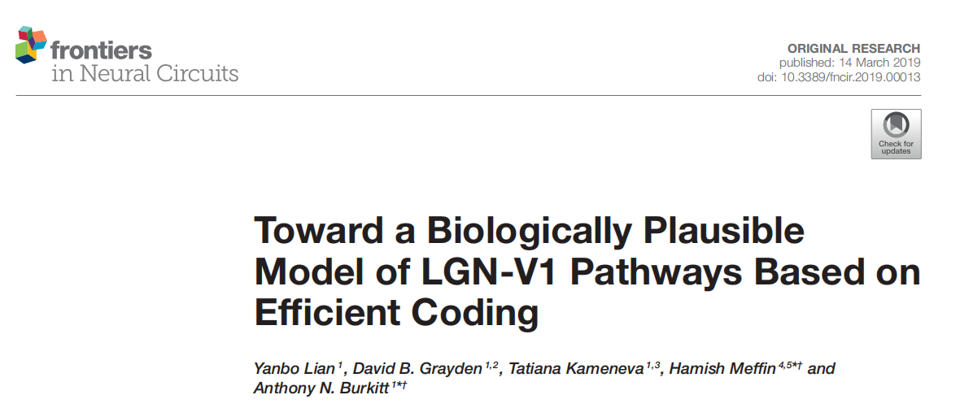
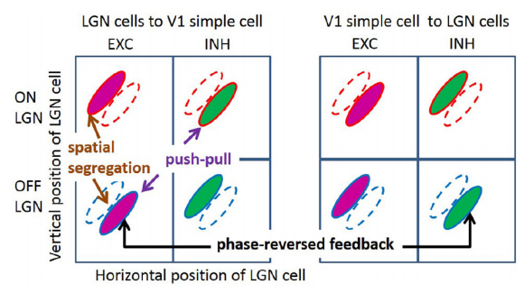
2019
构建了一个两层网络，第一层LGN cell（ON/OFF），第二层simple cell，加入一些生物约束，复现简单细胞的一些实验观察的现象。
生物约束：
①分离ON/OFF channel，分离兴奋性连接与抑制性连接
②非负的神经元响应
③赫布学习规则
④加入V1到LGN的反馈连接
复现实验现象：
①simple cell分离的ON/OFF区域
②push-pull responses
③phase-reversed cortico-thalamic feedback
④simple cell不同形状的感受野
⑤orientation tuning对比不变形

Slide 3
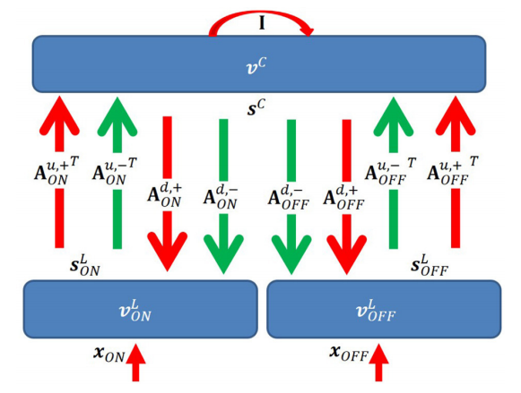
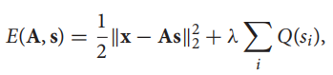
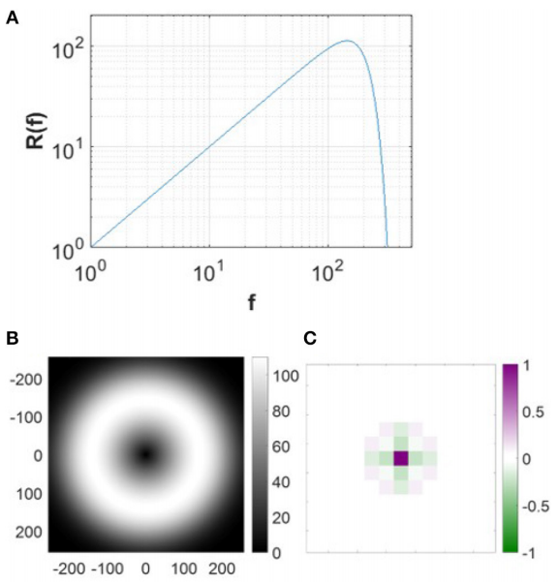
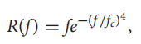
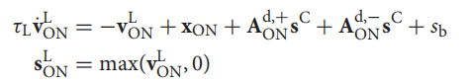
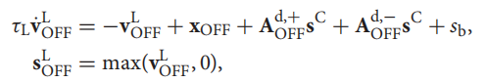
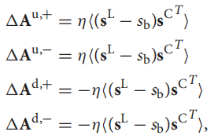
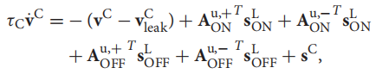
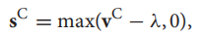
Efficient coding：
Simple cell表征视觉输入时，他们的spiking rate独立且少取大值(长尾分布)，即为求解如下的优化问题
输入与重构输入误差的平方和，第二项是个罚函数使s尽可能小。求这个最小化问题就是求输入的稀疏表示
Input
10 pre-whitened 512*512 pixel images of natural scenes 16 *16 pixel image patches
neural dynamics
First layer
Second layer
Learning rule
Notes:
结构上存在一个不够真实的点，皮层到LGN有抑制连接

Slide 4
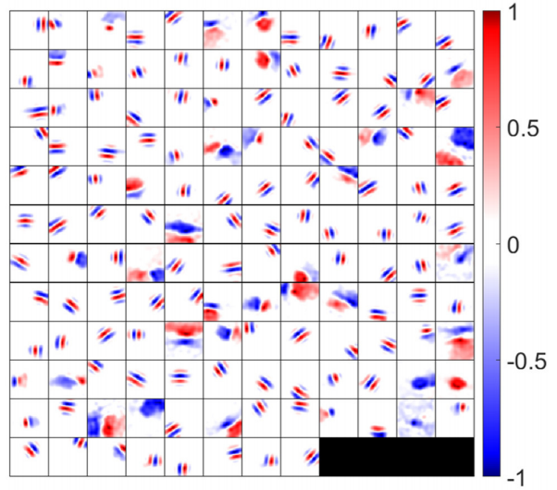
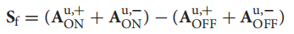
学习之后LGN与V1之间突触权重与实验观察到V1感受野有相似的空间结构
Synaptic field

Slide 5
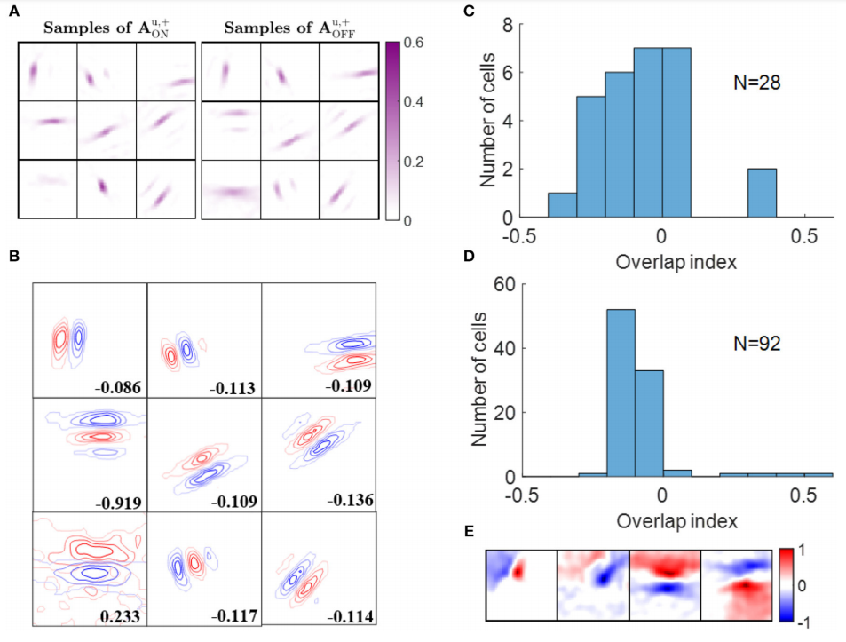
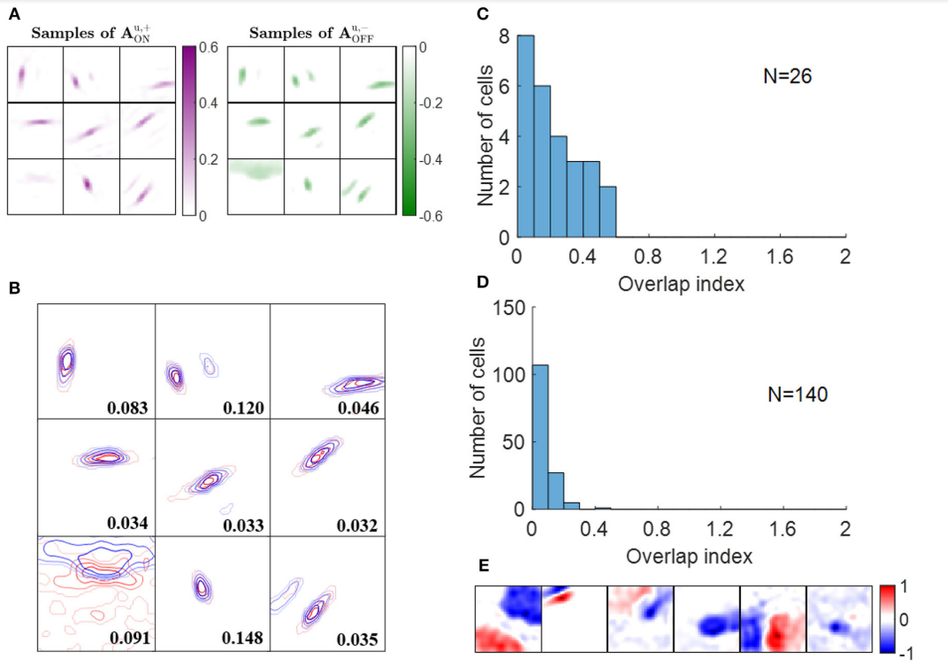
实验结果
Segregated ON and OFF Sub-regions
Push-Pull Effect
ON型兴奋性连接与OFF型兴奋性连接通常相邻且没有overlap
92 cells中有88个overlap index小于0.1

Slide 6
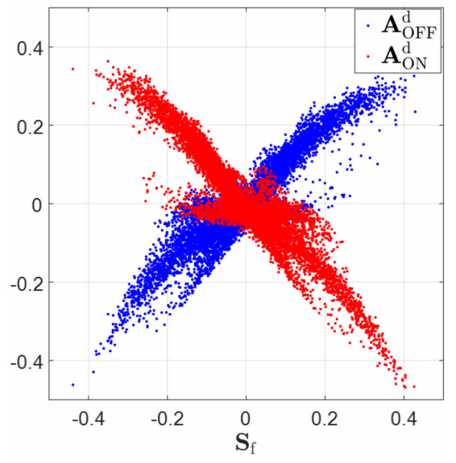
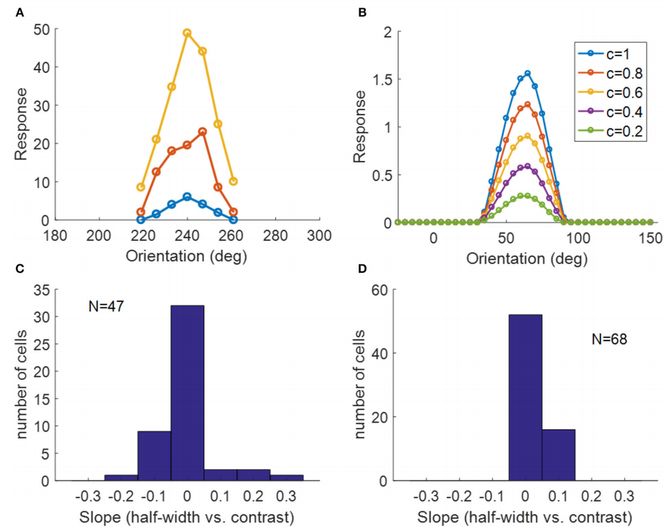
Phase-Reversed Feedback
Contrast Invariance of Orientation Tuning
synaptic feedback from V1 to LGN is phase-reversed with respect to the feedforward connections
the width of the orientation tuning curve is maintained when the contrast of the stimulus changes

Slide 7
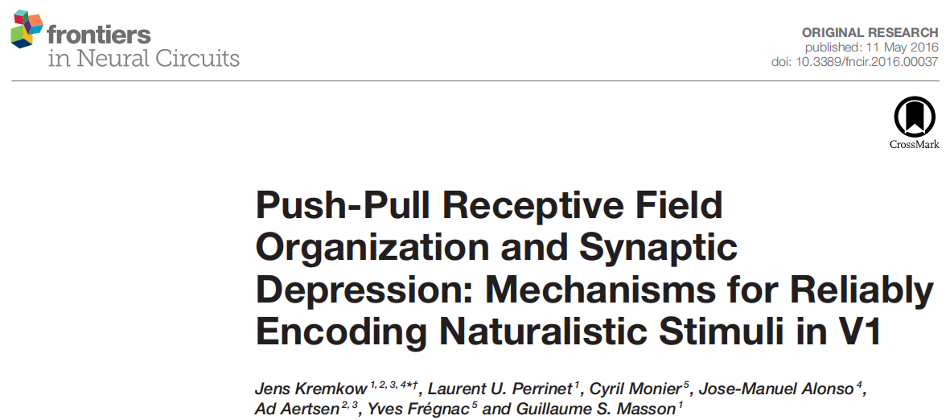
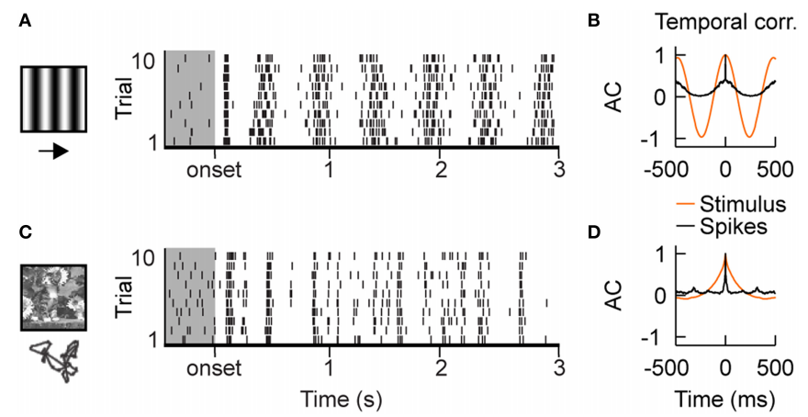
2016
构建一个LGN-V1点模型，复现人工刺激和自然刺激下神经元放电不同模式，并讨论原因以及push-pull RF organization，synaptic depression对放电模式的影响。
移动光栅：密集，spike timing变化大
自然刺激：稀疏，较同步

Slide 8
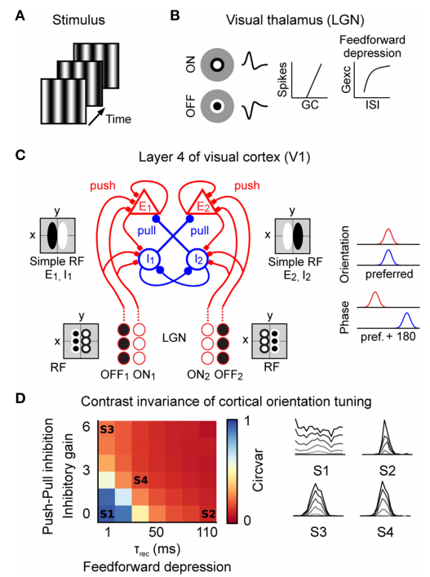
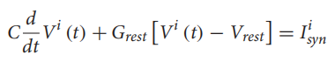
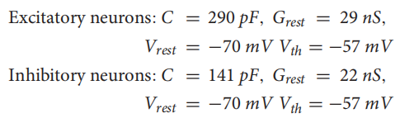
input
①drifting sinusoidal grating(spatial frequency of 0.8 cpd and a temporal frequency of 2 Hz)
②naturalistic movies(a cat in a flower field according to an eye movement scan path)
cover 6.8°×6.8° visual field
61×61 ON-center cells，61×61 OFF-center cells
spatial center-surround profile defined by a difference of Gaussians and its bi-phasic temporal profile as a difference of Gamma functions
neural dynamics
1600 excitatory (E) and 400 inhibitory (I) neurons
Notes:
excitatory and inhibitory neurons are more likely to be connected to neurons with similar orientation preference
Excitatory connections are established between neurons of similar phase but inhibitory neurons connect preferentially to cells having opposite phase.
Probabilistic sampling of the Gabor function yield around ∼60–100 incoming synapses from the LGN
Feed-forward depression at the thalamic input onto cortical cells
was modeled by short-term plasticity
the ratio between the area of the inhibitory
synaptic response (IPSP) and the area of an excitatory synaptic response (EPSP) of amplitude 1 nS

Slide 9
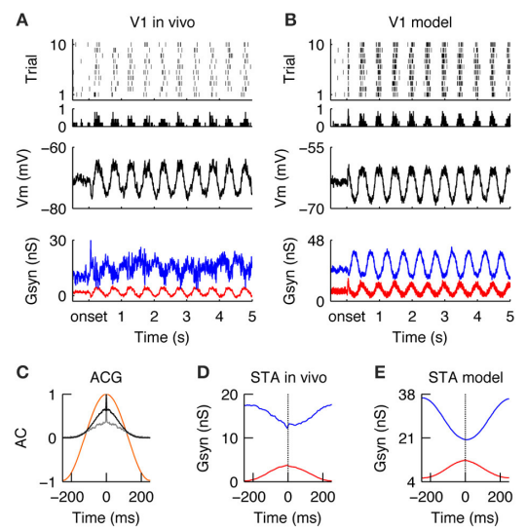
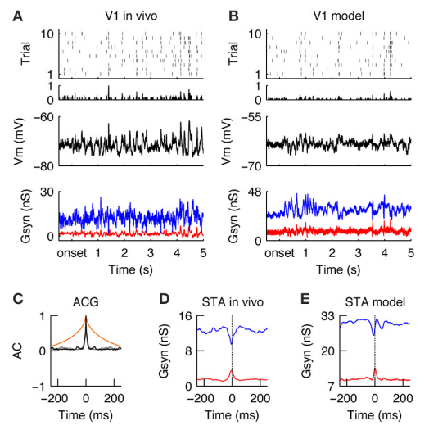
V1 Responses during Drifting Gratings in the Model
Encoding of natural stimuli by V1 simple cells
dense, variable, and temporally imprecise
the global V1 spiking activity was reduced ∼3-fold as compared to grating stimulus
Notes:
Gexc/Ginh synaptic inputs were now balanced and
tightly correlated

Slide 10
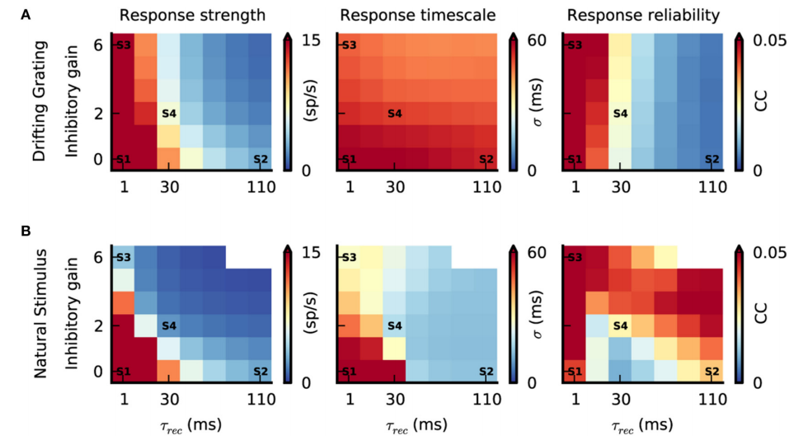
Push-pull inhibition：inhibitory gain (the ratio between the area of the inhibitory synaptic response (IPSP) and the area of an excitatory synaptic response (EPSP) of amplitude 1 nS, at resting potential.)
Feedforward depression：recovery time constant (1-100ms)
①Inactivating both push-pull inhibition (inhibitory gain = 0) and feedforward depression (τrec = 1 ms) resulted in strong V1 responses for both stimuli
②push-pull inhibition and feedforward depression can reduce response amplitude in V1, while increasing temporal precision to achieve a sparse and temporally precise cortical representation of natural stimuli.
③However, there is a small range of paired values for which their interplay results in realistic dynamics, switching from
dense/unreliable to sparse/reliable when increasing stimulus complexity
Notes:
changed the peak amplitude of the inhibitory synapses in the V1 network
A small τrec would result in a fast recovery and, thus, in a weak depression, whereas a large τrec would produce both
slow recovery and strong depression

Slide 13
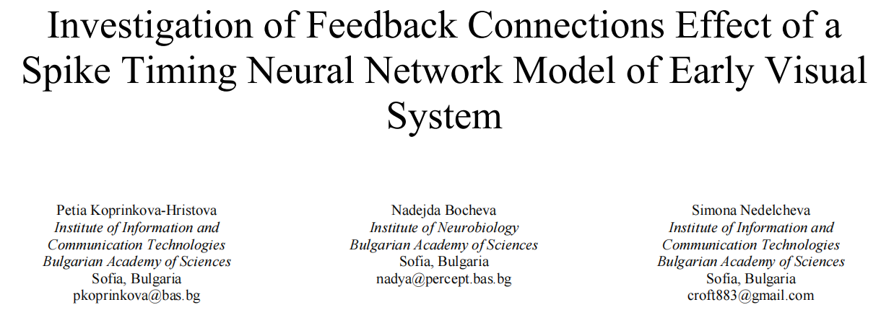
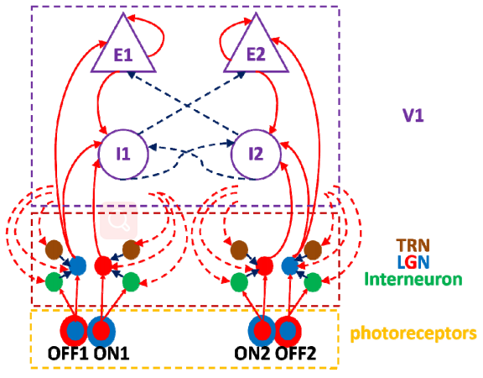
2018
构建了一个retina，LGN，V1的三层网络，结构上加入了通过interneuron与TRN介导的V1抑制性反馈连接。
研究不同连接强度以及有没有反馈结构对模型的影响
Photoreceptors/LGN layer 400 cells，视野直径7.5°，ON and OFF receptors交替排列
V1 1000 cells, E:I = 4:1

Slide 14
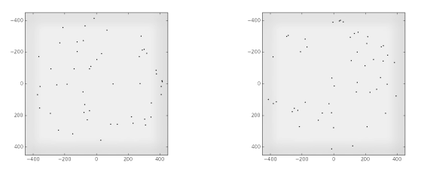
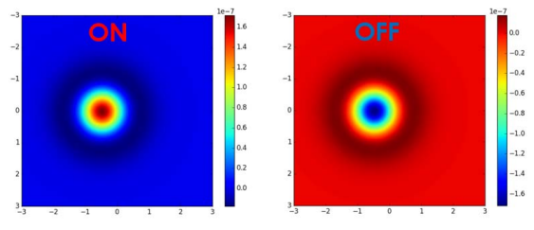
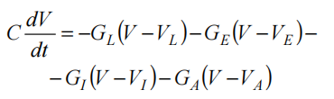
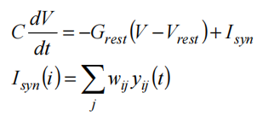
spatiotemporal filter
Input: a movie consisting of 50 frames with 50 dots whose positions vary from frame to frame
Retina model:
spatial component : DoG model
temporal component : bi-phasic profile determined by difference of two Gamma functions
LGN model
V1, Interneurons and TRN Neurons model
Notes:
GA is the conductance of the potassium-mediated after hyperpolarization ion channel

Slide 15
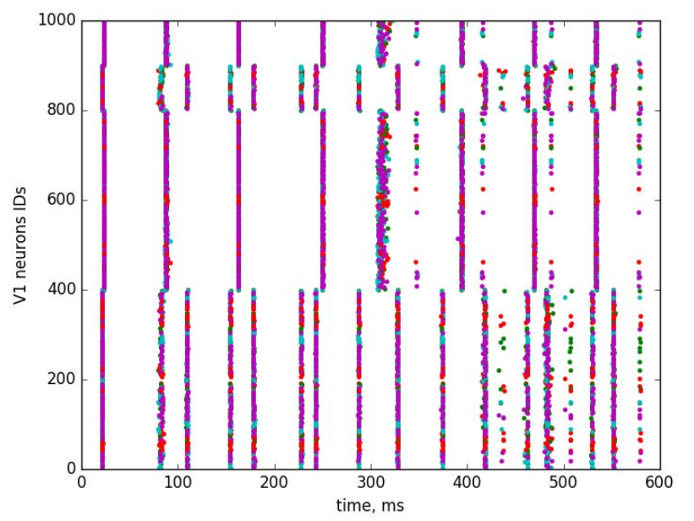
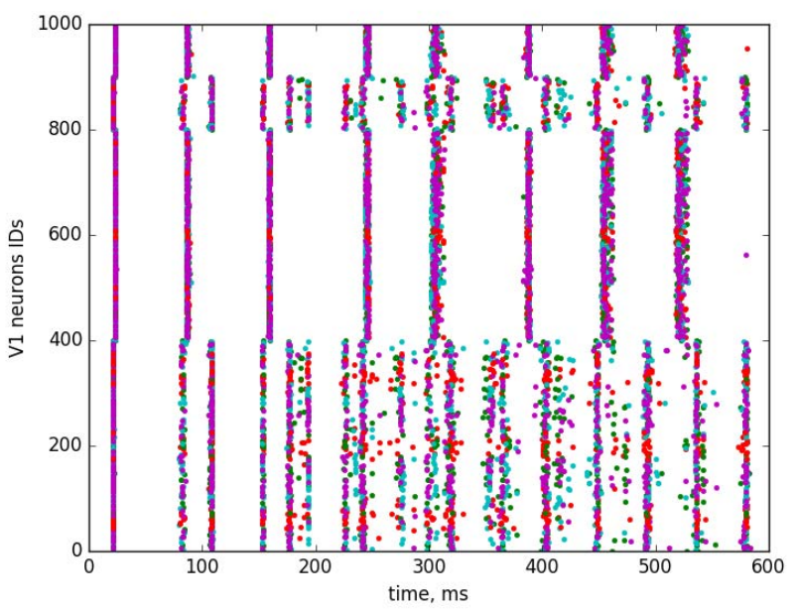
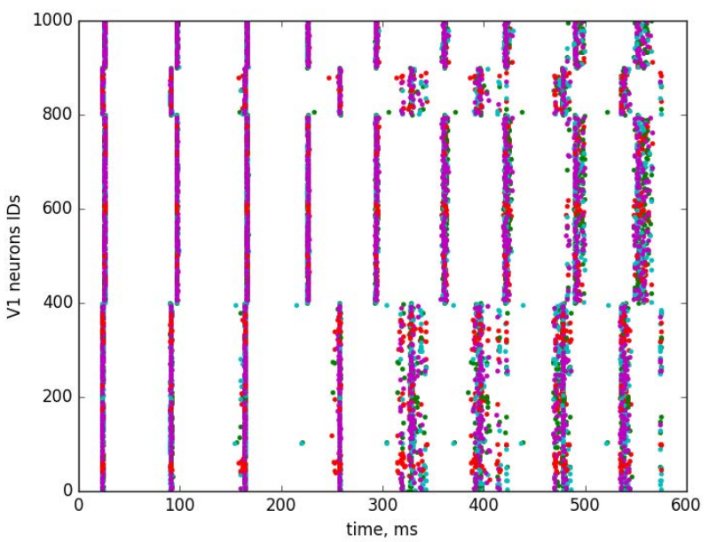
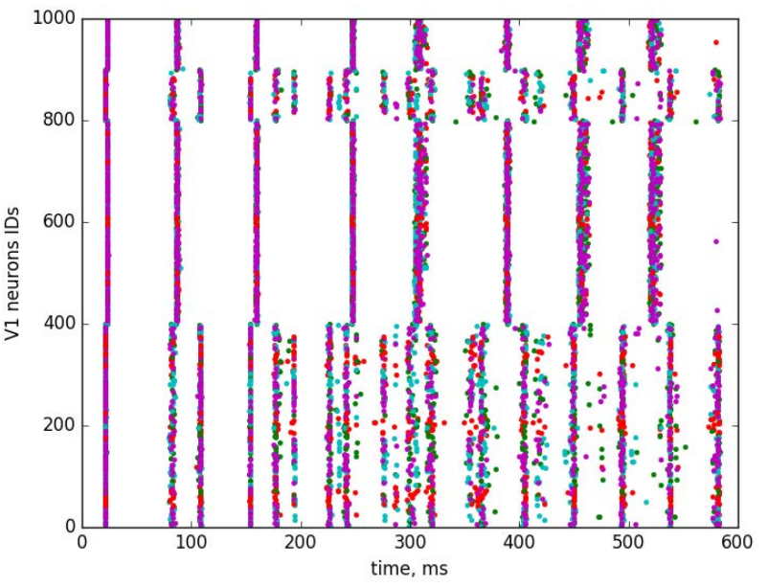
记录V1神经元活动
No feedback
Direct feedback from V1 to LGN
direct feedback from V1 to LGN and via interneuron
presence of feedback connections between LGN and V1 areas increased asynchrony in moments of spiking of neurons with different orientations
direct feedback from V1 to LGN
and via TRN neuron

Slide 16
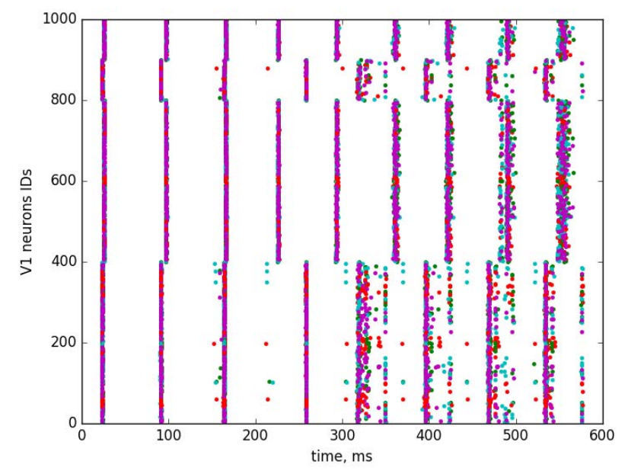
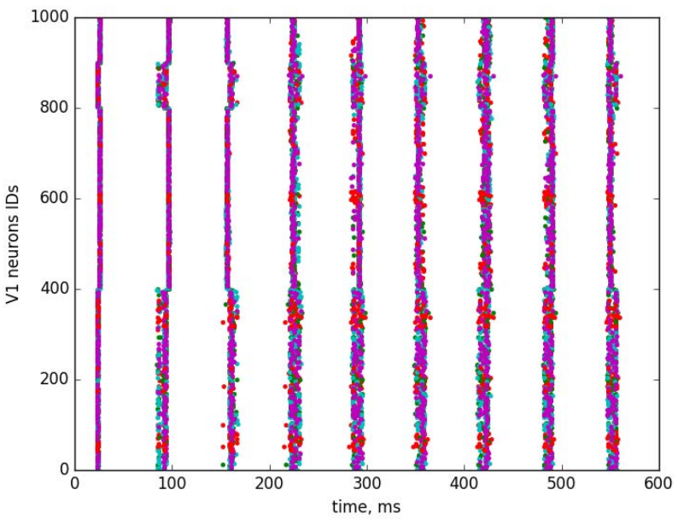
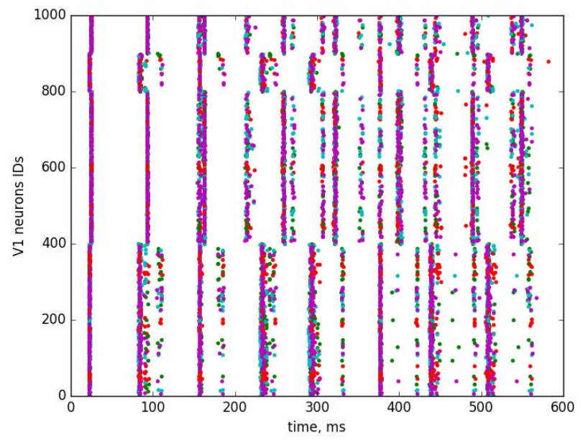
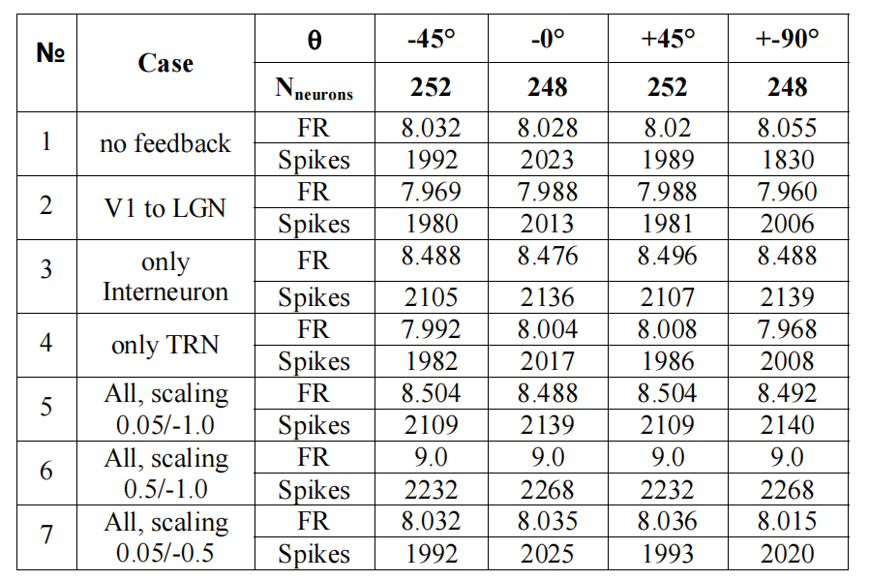
feedback through interneuron, TRN and LGN together with three different combinations of values of the strength of feedback connection weights
增加feedforward强度使神经元活动更加同步
No feedback比direct feedback有更高的firing rate和spike number
Interneuron对firing rate增加比较明显，而TRN几乎没有影响

